Slide 1



Governance work 2023
Recap: June - October 2023

Slide 2
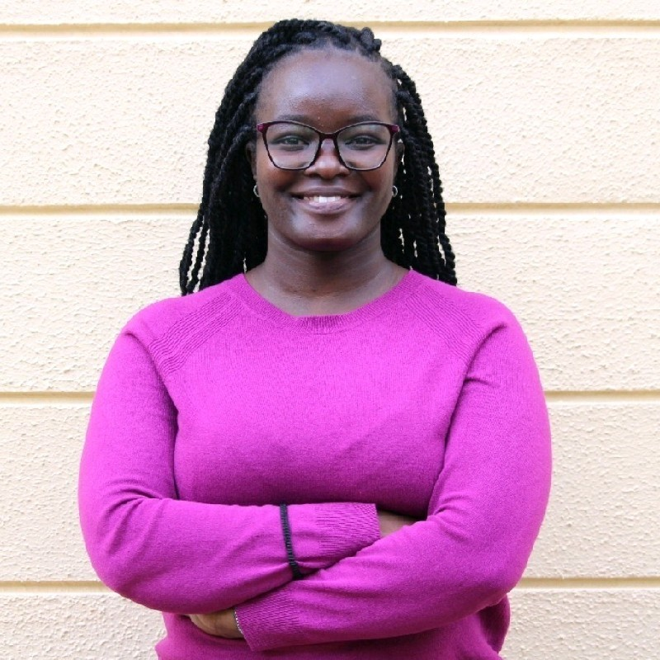
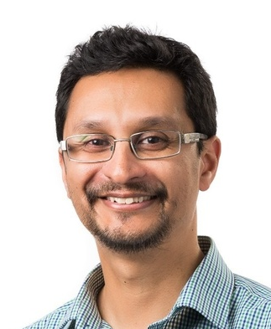
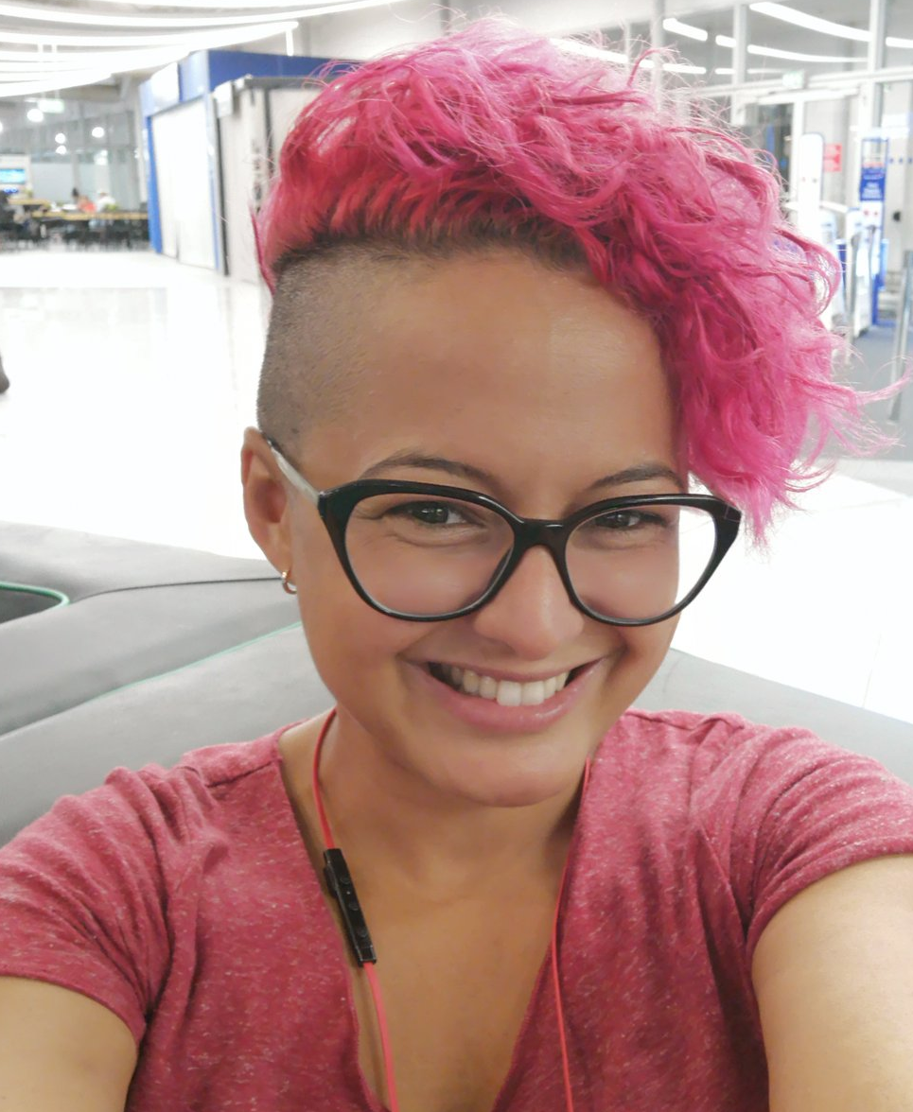
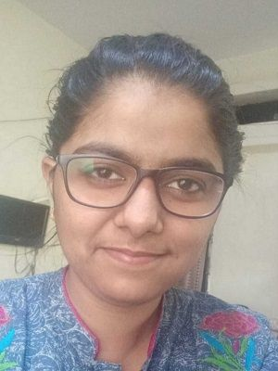
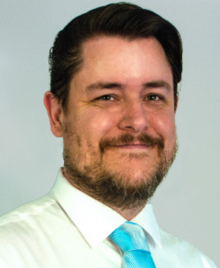
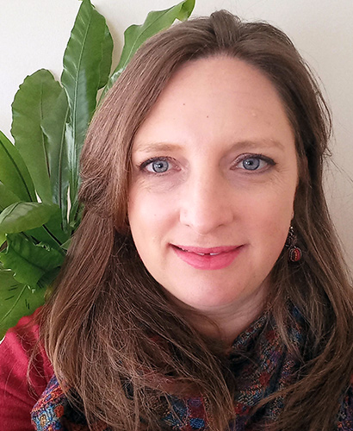
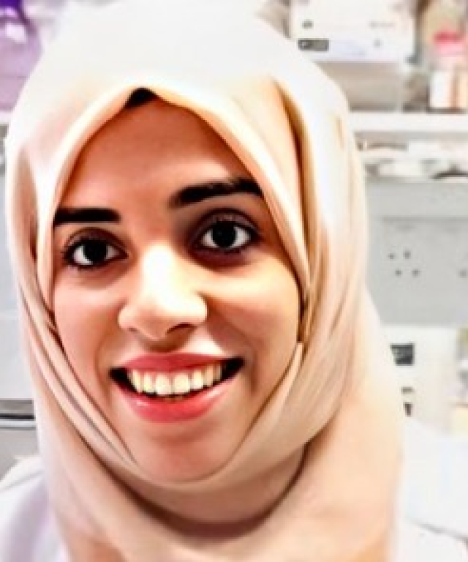
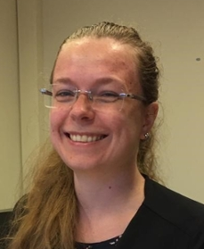
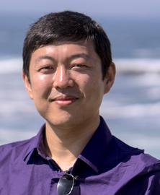
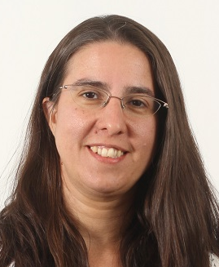
OLS Governance Committee Members
Bérénice Batut
Malvika Sharan
Laurah Nyasita Ondari
Rowland Mosbergen
Sara El Gebali
Saranjeet Kaur
Stephen Klusza
Anelda Van Der Walt
Batool Almarzouq
Esther Plomp
Hao Ye
Laura Ación

Slide 3
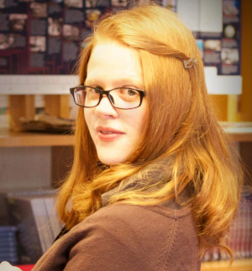

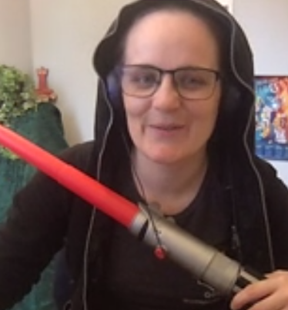
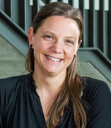

OLS Team and Board’s involvement in Governance work
OLS Secretary
OLS Board
Fellowship & Finance Manager
Dir. of Partnership & Strategy
Executive Dir.
Biz-Dev + Firefighter
Dir. of Technology & Learning
Dir. of Operations & Finance
Patricia Herterich
Malvika Sharan
0.1 FTE
Yo Yehudi
0.6 FTE
Bérénice Batut
0.1 FTE
Emmy Tsang
0.1 FTE
Responsible
Consulted & Informed
Accountable (Liaisons)

Slide 4

Timeline for OLS Governance (gov) work so far …
Nominations from the OLS board was made to invite 10 OLS members to represent different areas of work in gov committee
1st committee meetings took place. The collective suggestion was to take time to review governance documents. Comms established.
The committee has made input on vision and mission, organisation structure, governance committee participation and logistics.
April-May 2023
27 June 2023
June-October 2023
Jan - May 2023
May-June 2023
July 2023
Documentation developed by Malvika and reviewed by the Board for different processes to support the gov work
10 members were invited. The onboarding document along with the initial set of process documentation was shared
Malvika created a 6-month plan for the committee to review the governance document before taking on other areas of work.
openseeds
mentoring & training program

Slide 5
Timeline for OLS Governance (gov) work so far …
“This is the inaugural governance committee. It makes sense to take it a bit slower to build as strong a foundation as we can for what this committee does.” - An OLS Gov Committee Member
Nominations from the OLS board was made to invite 10 OLS members to represent different areas of work in gov committee
1st committee meetings took place. The collective suggestion was to take time to review governance documents. Comms established.
The committee has made input on vision and mission, organisation structure, governance committee participation and logistics.
April-May 2023
27 June 2023
June-October 2023
Jan - May 2023
May-June 2023
July 2023
Documentation developed by Malvika and reviewed by the board for different processes to support the gov work
10 members were invited. The onboarding document along with the initial set of process documentation was shared
Malvika created a 6-month plan for the committee to review the governance document before taking on other areas of work.
“Where we think biggest governance needs are - where we need to be more democratic / transparent / consistent, then learn about those processes, before just starting to advise how to fix it.” - An OLS Gov Committee Member
openseeds
mentoring & training program

Slide 6
Timeline for OLS Governance (gov) work so far …
Slack for Gov+Board, Slack only for Gov, mailing list, monthly meetings, documentation folder, meeting notes, Friday coworking for social interactions outside meetings.
Many constructive feedback were made by the committee. Optimal time contribution is currently 2-4 hours/month. Many questions and suggestions have been raised.
Nominations from the OLS board was made to invite 10 OLS members to represent different areas of work in gov committee
1st committee meetings took place. The collective suggestion was to take time to review governance documents. Comms established.
The committee has made input on vision and mission, organisation structure, governance committee participation and logistics.
April-May 2023
27 June 2023
June-October 2023
Jan - May 2023
May-June 2023
July 2023
Documentation developed by Malvika and reviewed by the board for different processes to support the gov work
10 members were invited. The onboarding document along with the initial set of process documentation was shared
Malvika created a 6-month plan for the committee to review the governance document before taking on other areas of work.
An onboarding document with list of all documents for gov as well as declaration of participation, CoI and honoraria details were shared.
Anelda and Rowland advised to structure meetings and asks from the committee. Malvika applied for IOI grant to pay for 2 gov fellows
Pending decision
openseeds
mentoring & training program

Slide 7
Outcomes of meeting 1: June 2023
A reformatted low-weight onboarding document:
Stripped down version of initial document needed for gov committee onboarding (CoC, resource links, declaration docs): https://docs.google.com/document/d/1YzoVM1HYxww3szMxpBMGZFgIZGnPWwQvL1z8DFoxhxc/edit
Governance document was split into smaller document for different governance committee members to review: reducing burden for everyone to review and comment on the full process
6-months review plans: https://docs.google.com/spreadsheets/d/1RLfElUNqrw2nn37QmwSqEYw7W5_0J83hMz5GmZp5sWw/edit#gid=0
open seeds
mentoring & training program

Slide 8
Outcomes of meeting 2: July 2023
Vision and mission: Keywords used in the inputs shared by the committee
Awareness
Understanding
Equity
Path Forward
Possibilities
Emotionally aware
Restorative
Daring
Openness
Culture Change
Facilitate
Kindness
Corrective
Reimagination
Meaningful
New generation
Global leaders
De-silo
Participation
Libration
Opportunities
Diverse
Respect
International
Collective
Human value
Decolonisation
Collaboration
Political
Reliance
Redefine
Supportive
open seeds
mentoring & training program

Slide 9

OLS Priority Framework 2023-24 to Align Vision & Mission With
Open Science Training
OLS Seeds ongoing - CZI (2022-2024)
Training with NASA-TOPS (2024-2026)
Research on Open
Impact research (WT)
Widening Participation (Turing)
Open Incubator
OLS-SSI Fellowship (SSI)
Resident Fellows (CZI, Turing)
Catalyst (cross community + Africa & LatAM)
OLS Community Governance
CZI (formalise leadership)
WT, IOI (pending approval)
Research on open
Community-based analyses to inform activities and interventions to increase the adoption of open science principles
Open incubator
Hands-on support to empower a next generation of open leaders in science
Enabling the adoption of open science principles in local communities
Open Science Training
Online mentoring and training programmes to enable individuals and teams worldwide to learn about and adopt open science practices
open seeds
mentoring & training program

Slide 10
OLS Internal organizing framework - For financial year 2023-2024
Open Science Training
Online mentoring and training programmes for individuals and teams worldwide to learn about and adopt open research practices.
Current work streams:
Open Seeds
NASA TOPS
What makes us different?
Curriculum development & pedagogical expertise specifically in teaching researchers
Programmes built with a global community of experienced community builders and open practitioners
Research on Open
Community-based, landscape and longitudinal analyses to inform activities and interventions for widening participation in research.
Current work streams:
Impact research (supported by the Wellcome Trust)
Turing Skills Policy Award
What makes us different?
Researchers with demonstrated track record in researching and influencing open movement
Inclusivity & equity-centred approach to research: train & incubate independent leaders, compensate contributors, foster community & collaborations
Open Incubator
Hands-on support to empower the next generation of open leaders in research.
Current work streams:
Fellowship programmes
Facilitators training
Catalyst
Fiscal hosting (to come)
Grant writing training (to come)
What makes us different?
High touch: we work with leaders individually on their personal development
Cross-community collaboration to support local capacity and infrastructure
Draft: https://zenodo.org/records/8349155

Slide 11
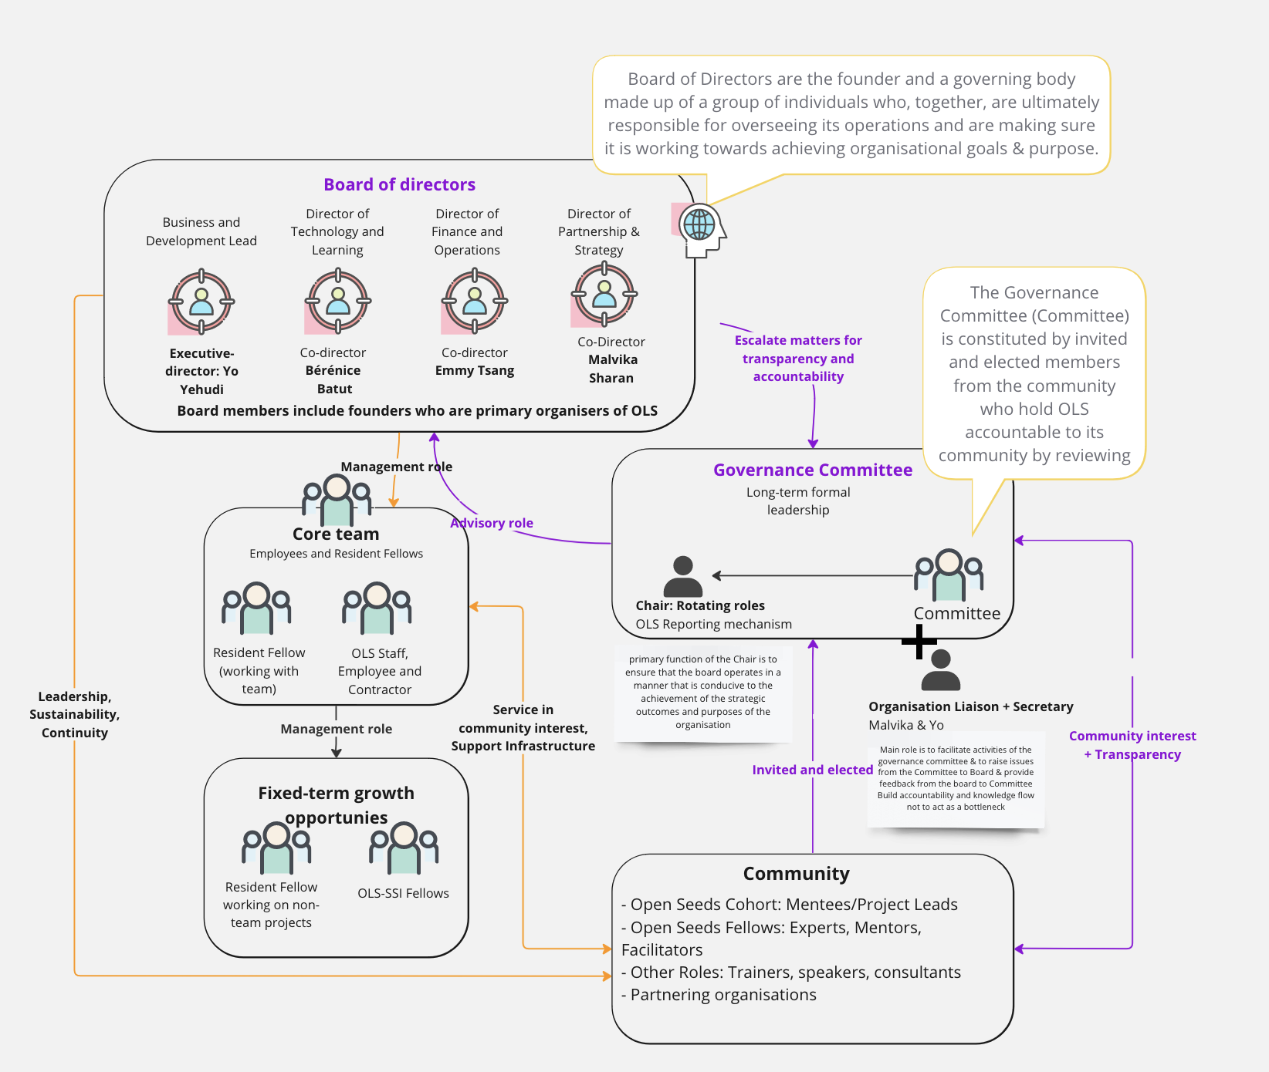
Outcomes of meeting 3: August 2023
OLS org chart: how different groups in OLS interact through governance work
A visual representation: https://miro.com/app/board/uXjVMo-DiLc=/
Clarity of how information flows between the committee and board
Clear definition of the org Liaison from the board and a non-board Secretary (with a RACI for them)
Rotating chair roles (to start in 2024)
Plans to make clear how board members will be elected/selected
open seeds
mentoring & training program

Slide 12

Outcomes of meeting 4: September 2023
Feedback on the process so far:
Priority to finalise a decision framework for the committee & identify next steps.
Interest to plan how to proceed: rename the committee to reflect advisory role.
Currently it’s a bit unclear who makes decisions and when they are taken?
Consensus isn’t necessarily needed as long as all opinions and advice makes it to the board.
We should finalise a decision framework to ensure transparency and formalise to ensure EVERY committee member is heard.
Transparency process status:
Governance meetings monthly: Governance process is being reviewed in 2023. Summary shared via shared notes → Slack (crosspost via email)
Update about OLS work: Decisions are made by the board based on funding priorities that support OLS operations and goals. Yo has started to share updates. Testing format & frequency.
TO BE FINALISED: How updates are shared with community? Who does that communication? How to prioritise future work?
open seeds
mentoring & training program

Slide 13
State of governance work, as of October 2023
Expectation alignment
Process documentation still remain a priority for OLS team to clarify how the committee will work. We should finish the review before diving into other areas of work. Documents will open for the community feedback.
Committee would like to involve in other work. We should set priorities for the committee in 2024 for advisory work.
OLS team continue to maintain documents, take care of logistics, coordinate meetings, take actions based on recommendations.
Documents reviewed: See next slide
What has surfaced?
Gov committee expressed to be involved in advisory capacity (2-4 hrs time commitment)
Committee meetings are where the OLS team will escalate a matter to the committee, and vice versa. Urgent issues will use Slack/email → meetings for feedback.
Many yearly priorities are bound to funding commitments but the committee will provide accountability through auditing, transparency and fair review processes through which advice and recommendations are made
Instead of a committee chair, preference for rotating chair/accountability roles from 2024.

Slide 14
State of governance work, as of October 2023 Document review status
Document | Status
Onboarding handbook for the Governance Committee of OLS | Approved
OLS-Vision-and-Mission | Ongoing
OLS Guiding Principles | Paused - and internal priority framework was shared: https://zenodo.org/records/8349155
OLS organisation structure and community roles document | Reviewed. Should be published on website.
OLS Organisation chart | Reviewed, A Miro board was created: https://miro.com/app/board/uXjVMo-DiLc=/?share_link_id=229643378131. Should be shared on GitHub and linked to website at the end of review stage.
Governance Committee Membership | Two unresolved comments to be agreed on. Discuss what the election process looks like
committee participation and membership | Some unresolved comments -- agree on the renewal and step down process.

Slide 15


We will keep this slidedeck live
Information for the next meetings and updates will be added here

